Slide 1
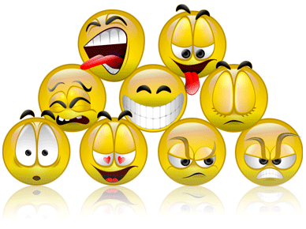
FEELINGS AND EMOTIONS

Slide 2
Happy

Slide 3
Sad

Slide 4
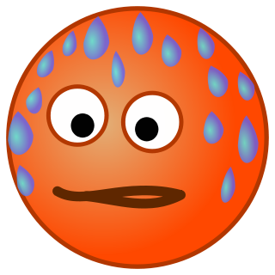
Hot

Slide 5
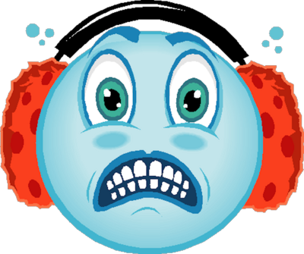
Cold

Slide 6
Angry

Slide 7
Hungry

Slide 8
Thirsty

Slide 9
Surprised

Slide 10
Scared

Slide 11
Tired

Slide 12
Nervous

Slide 13
Bored

Slide 14
Sleepy

Slide 15
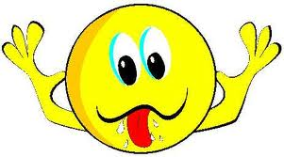
Funny

Slide 16
Excited

Slide 17
Ill

Slide 18
In love

Slide 19
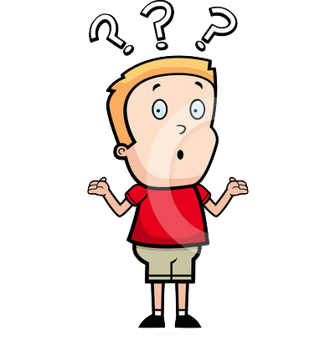
VIDEO: EMOTIONS
Listen, repeat and mime the face.

Slide 20
How are you today?
Hello! Hello!
How are you today?
I am happy! Happy! Happy!
Hello! Hello!
How are you today?
I am sad! Sad! Sad!
Hello! Hello! How are you today?
I am hungry! I am hungry today.
Notes:
www.youtube.com/watch?v=teMU8dHLqSI

Slide 21
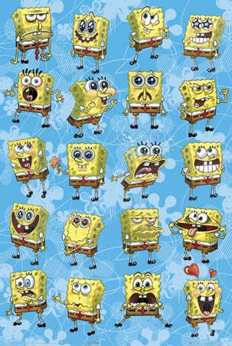
How is SpongeBob feeling?

Slide 22
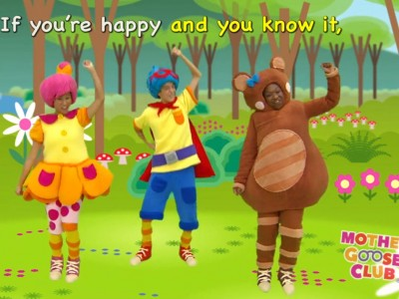
SONG

