Slide 4
مائل
منكسر

Slide 5
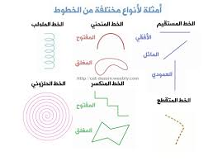
https://quizizz.com/media/resource/gs/quizizz-media/quizzes/f8789d8f-179b-4d96-a293-c1fdb3891340

